Slide 1

Unit-7 IoT Security
IOT and Applications
GTU # 3160716
Prof. Kalpesh H Surati
Computer Engineering Department
Kalpesh.surati@darshan.ac.in
+91 99250 10033

Slide 2
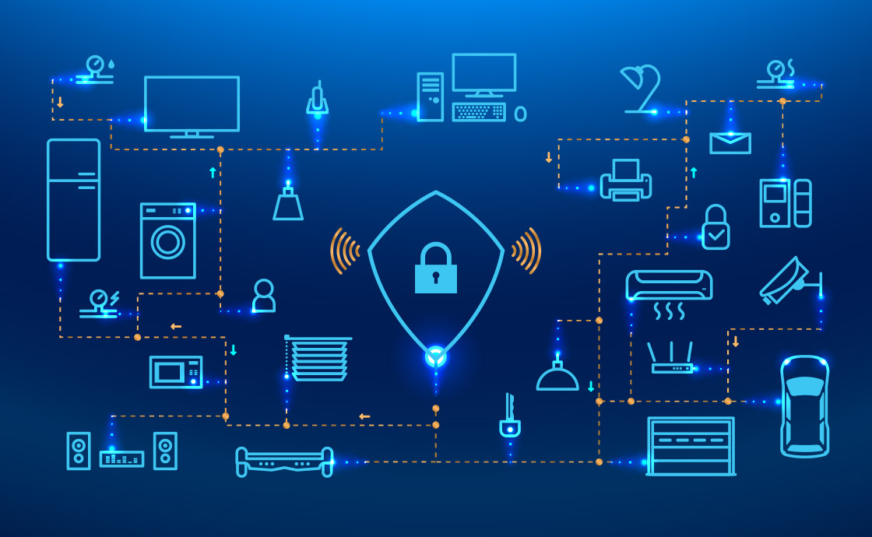
Introduction to IoT Security
Overview
IoT is growing day by day, as we know it’s about data and controlling of physical devices.
Security and privacy are the two major concern in the field of IoT.
Huge amount of sensed data contains private information so need to protect.
All kind of securities of physical devices is considered in the IoT security.
IoT is not possible without the Internet so Internet and network security issues also should be considered in it.

Slide 3
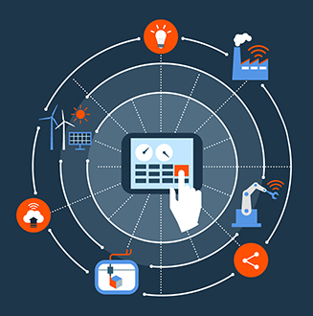
Introduction to IoT Security
Overview
IoT security is not traditional cybersecurity
It’s a fusion of cybersecurity with other engineering disciplines.
It is much more than data, servers, network infrastructure, and information security.
It includes the direct monitoring and control of the physical systems connected over the Internet.
IoT devices are physical things, many of which are safety-related.
The compromise of such devices may lead to physical harm of persons and property, or even death

Slide 4
IoT Security Prospective
IoT System Functionalities from Security Prospective
Microcontroller unit carries firmware, need to protect it even while updating patch.
Massage channels during the paring stage need to protect in the public networking, like
Wi-Fi, Zigbee
Bluetooth
NFC
An appropriate protocol should be followed while connecting the user and device.
An authentication process is needed when the controller linking to a port in local network.
Software
Data
OS/Firmware
Hardware
Networking
Multidimensional Prospective of IoT Security

Slide 5
IoT System Functionalities from Security Prospective
If the controller is no internet then cloud services are used for authentication. multidimensional
Big data analytics on the data collected are processed on cloud so cloud security is essential.
Abnormal behavior should be monitored like too many login attempts
Software
Data
OS/Firmware
Hardware
Networking
Multidimensional Prospective of IoT Security

Slide 6
IoT Security Architecture
Information with network security should be prepared with the following properties.
Authentication
Privacy
Undeniability
IoT will be needed extra care for advanced security and privacy across critical areas.
Application Layer
Smart Transportation
Environmental Observing
Information Service
Support Layer
Cloud and Smart Computing
Network Security
Management
Network Layer
Internet Portable
Communication Network and
Communication Protocols
Perceptual Layer
RFID Reader, Sensors and GPS
IoT Security Architecture

Slide 7
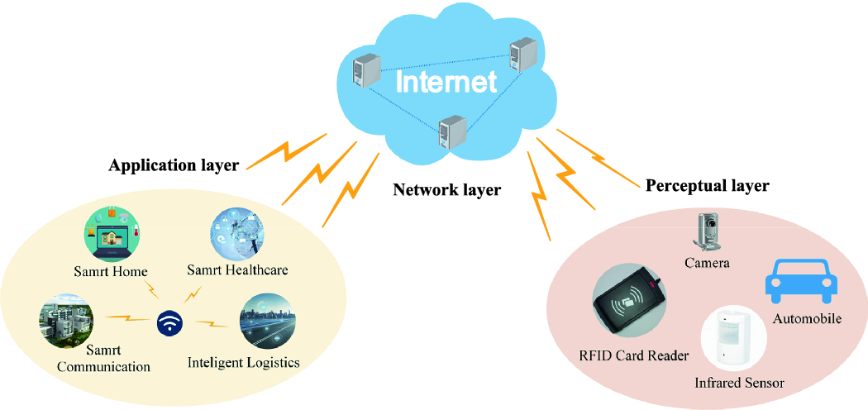
IoT Security Architecture
Perceptual Layer
Gathers all types of information with the help of physical equipment.
Information of
Object properties,
Environmental condition and
The different physical equipment like
RFID reader,
GPS,
All kind of sensors, etc.
It identifies the external world.
The key component in this layer is the sensors.
They are used for capturing and representing the physical world.

Slide 8
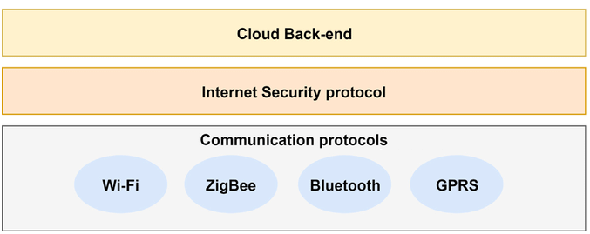
IoT Security Architecture
Network Layer
Responsible for the dependable broadcast of data and information from the previous level
Initially handling of the data collected from sensors, cataloging and polymerization.
The data broadcast is trusted on many networks like
Mobile communication network
Wireless network
Satellite networks, etc.

Slide 9
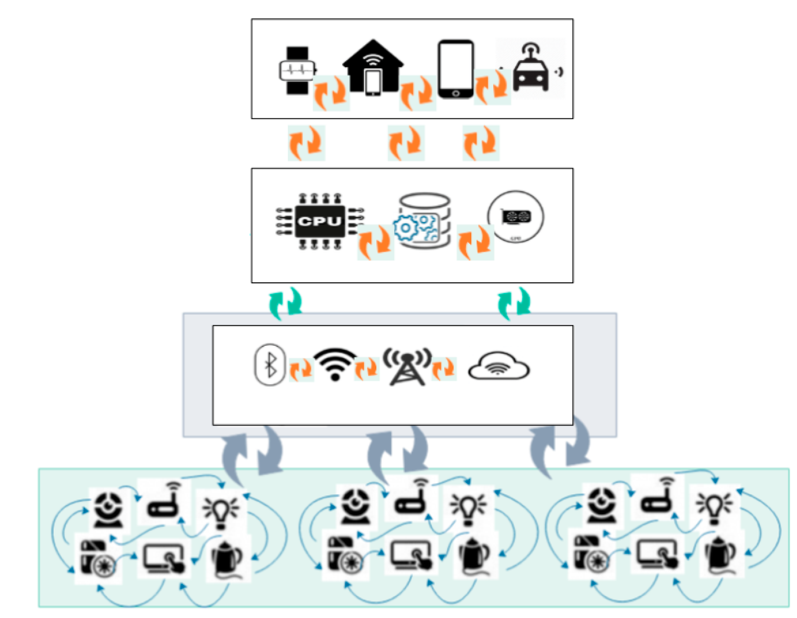

IoT Security Architecture
Support Layer
A dependable platform for the application layer.
Grid and cloud computing are mostly used for all kinds of intelligent computing powers.
This layers helps merge the application layer upward and the network layer downward.
Application Layer
This layer delivers the personalized services based on the users’ need.
It helps users access IoT through the interface using personal computer, mobile equipment, etc.
Application Layer
Support Layer
Network Layer
Perceptual Layer

Slide 10
Security Features Need Across Four Layers
Perceptual Layer
With a simple architecture and less power, this layers dose not have storage and computation power.
Appling public key encryption algorithm and frequency hoping communication is not possible here.
So security is necessary and needed for some threats from external network like DoS attacks.
Due to all the reason the sensor data to be protected for authenticity, integrity, and confidentiality.
Smart
Needs
Data Needs
Connectivity Needs
Physical Needs
Security Needs

Slide 11
Security Features Need Across Four Layers
Network Layer
Security vulnerabilities are like man-in-the-middle attack, still exists even the main network has enough safety feature.
Malwares and junk mails cannot be ignored.
Data blocking may occurs because of huge amount of data transmission.
Because of all the above reason security methods are needed.
Support Layer
It is a challenge to increase the ability to identify malicious data in this layer due to the huge amount of data processing and mining.
Application Layer
In this layer, security needs may differ from application to application
Data sharing property of the layer does lead to privacy problem, access control issues, and information revelation to unintended persons.

Slide 12
Security Requirements
A dynamic IoT technology has lots of security challenges.
The laws and regulations surrounding the challenges also play a significant role.
Perceptual Layer
Authentication is the first level of security measure and is always essential to prevent any illegal access to the node.
Information confidentiality is taken care during transmission between nodes
Because of limited resource, lightweight encryption technology may help in stronger data safety measures. It including cryptographic protocol and algorithms.
Similarly need care for the authenticity and integrity of the data in this layer
Network Layer
Establishing data confidentiality and integrity mechanism is the priority in these days.
Identity verification is one of the methods to avoid illegal nodes.
DDoS attack in the network is a serious issue in the IoT domain.

Slide 13
Security Requirements
Support Layer
Cloud computing along with secure multi-party computation falls under this layer of security needs.
Different encryption algorithms along with the encryption protocol and tougher system security technology are hence essential in this layer.
Application Layer
In the topmost layer, verification and key contract across the varied network needed as security features.
Also consider the user’s confidentiality protection in the layer.
Along with these two aspects education and management are also very imperative for data security.
This helps IoT security consulting and certification services.

Slide 14
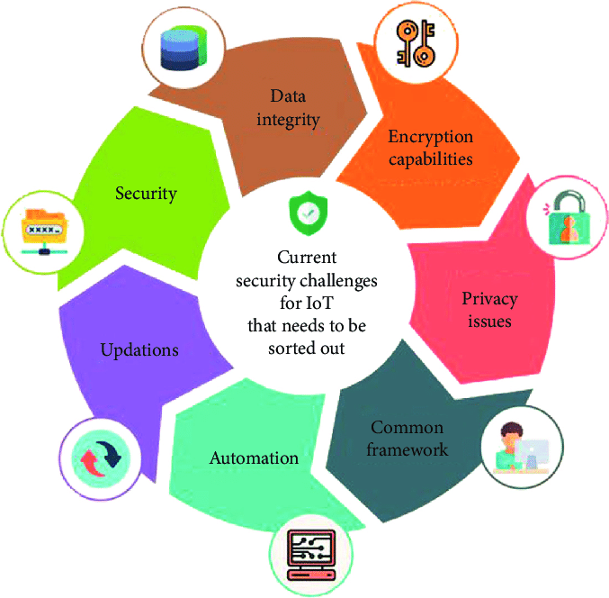
Challenges in IoT Securities
In the raising IoT field many problems to be solved to build an efficient and effective product.
Securities challenges are one of them.
Encryption
Encryption play key role in the security, but many devices cannot perform the complex encryption and decryption quickly because of limited resource.
Products with constrained resources are most likely to attacks.
Reverse engineering of algorithm is possible on it.

Slide 15
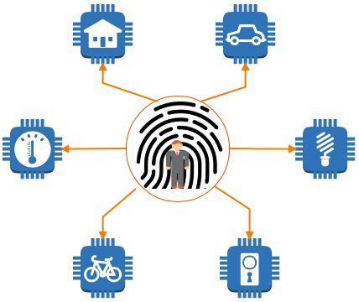
Challenges in IoT Securities
Authorization and Authentication
Device authorization and authentication is critical to securing IoT products
The things establish their identity before accessing gateway and other cloud related activities.
IoT platform with two factor authentication and usage of strong passwords or certificates can help to solve this issue.
They can also help to know which services or apps each device has access to throughout the system.

Slide 16
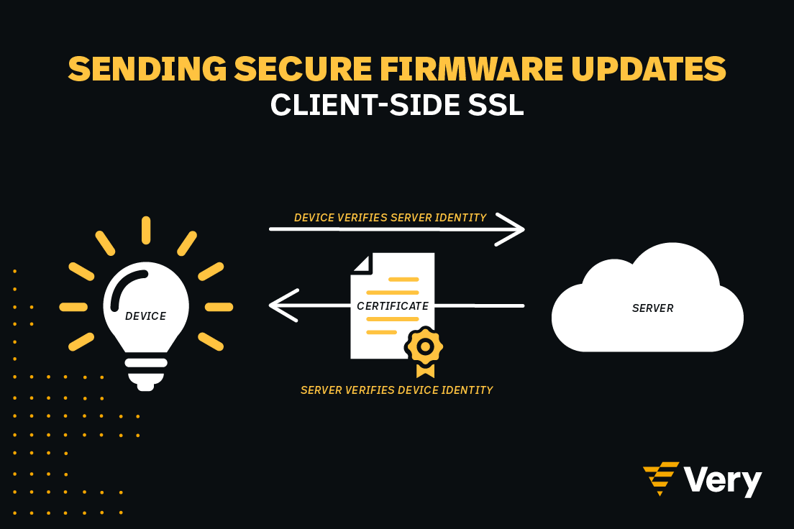
Challenges in IoT Securities
Firmware Updates
Device updates needs to be managed effectively.
Security patches to firmware or software will have a number of challenges.
Over-the-air updates may not be possible with all types of IoT devices.
The device owners may also not show much interest in applying an update to the system.
Communication Channel
The communication channel needs to be secure as well
Encrypting messages before transfer is good but it is better to use transport encryption and to adopt standards like TLS.

Slide 17
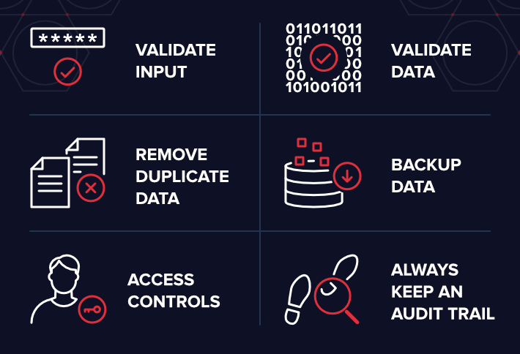
Challenges in IoT Securities
Data Storage and Integrity
The sensor data should be stored and processed securely.
Data integrity, including checksums or signatures, can help to make sure that the original raw data is not modified during transmission.
Data should be erased in a better way and should not be recovered in any part of the system.
Maintaining compliance with legal and regulatory framework is necessary and challenging also.

Slide 18
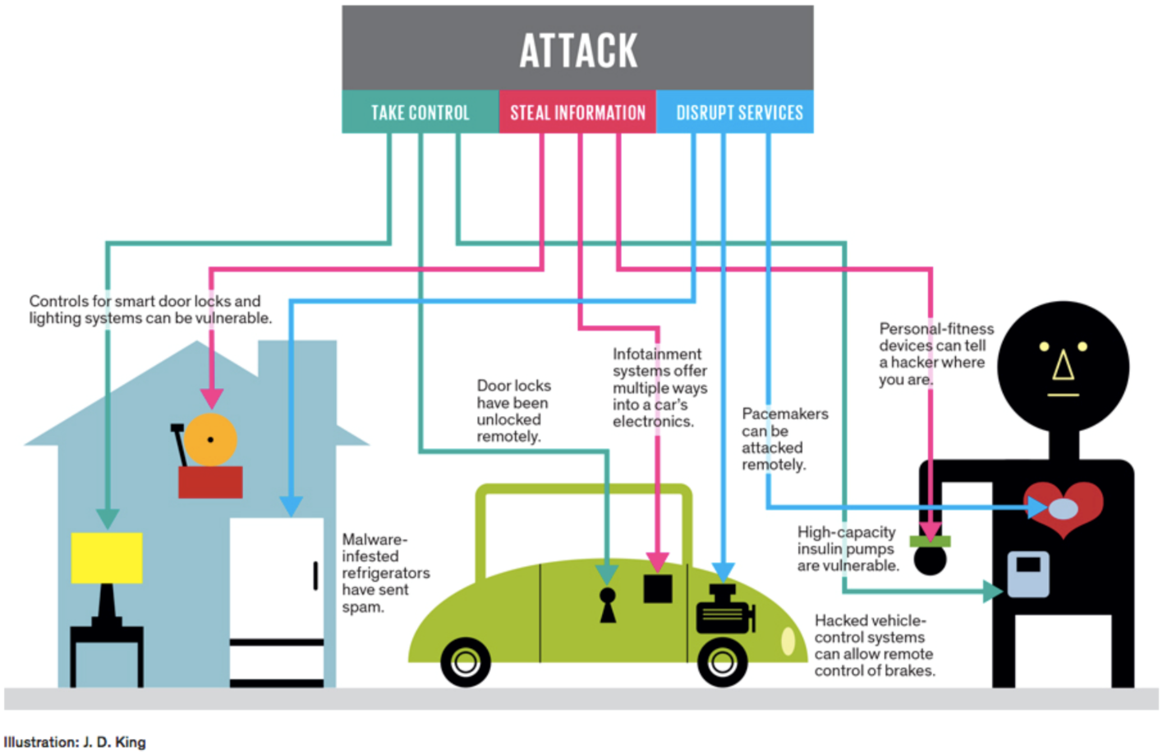
Challenges in IoT Securities
Application and Services
All applications and services should also be secured as they manage, process, and access IoT devices along with the sensor data.
Security vulnerabilities and breaches are unavoidable but security measures need to be taken to avoid conflict of interest.

Slide 19
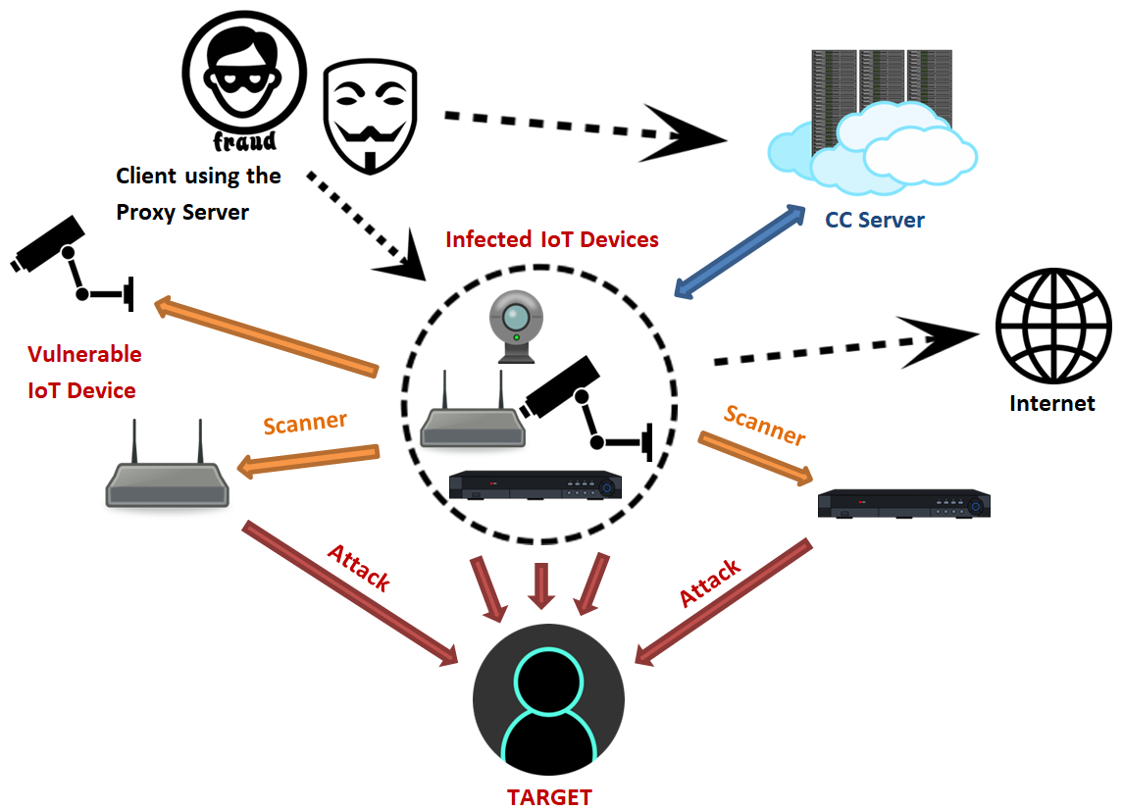
Mirai Botnet and the Algorithm
Mirai Trojan is the main reason of creation of Mirai Botnet.
A research group determined that it had evolved from a previously-created Trojan also known Gafgyt, Bashlite, Lizkebab, Bashdoor, Bash()day, and Torlus.
It was created using Executable and Linkable Format (EFL) binaries which is a common file format for Unix and Linux based Systems
Mirai malware uses a uniform scanning strategy where it randomly scan public IP addresses and selects a pair of username/password from a hardcoded dictionary list for the attack.

Slide 20
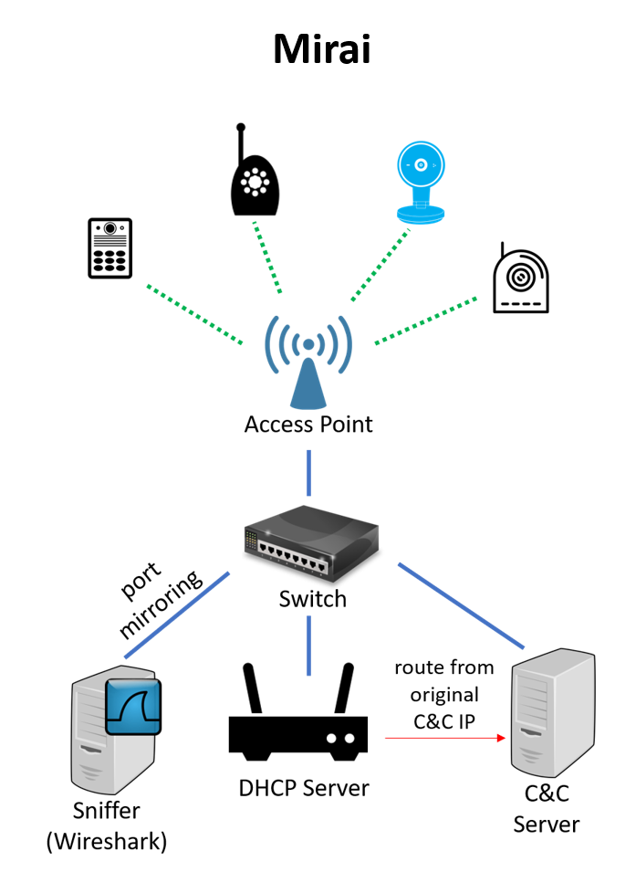
Mirai Botnet and the Algorithm
Devices that are infected by Mirai will continuously scan for IP address in the internet of the IoT devices.
Mirai then identifies the IoT devices that are vulnerable using the common factory default usernames and passwords.
Infect them with Mirai malware.
There are over a hundred of thousands IoT devices using default settings and making them vulnerable to infection.
It is also reported that a successor of Mirai is designed to hijack crypto currency mining operations.
The source code for the Mirai is made open-source and the techniques have been adapted in other malware projects.

Slide 21
Summary
A multi layered security design approach is most needed for managing IoT devices, sensor data, mobile and cloud related application
This enables us to maintain data privacy and integrity while also delivering IoT data, apps and services without any compromises.
In short, IoT development and advancement will bring more security related issues, which is always going to be the research focus in coming years.

